Slide 1
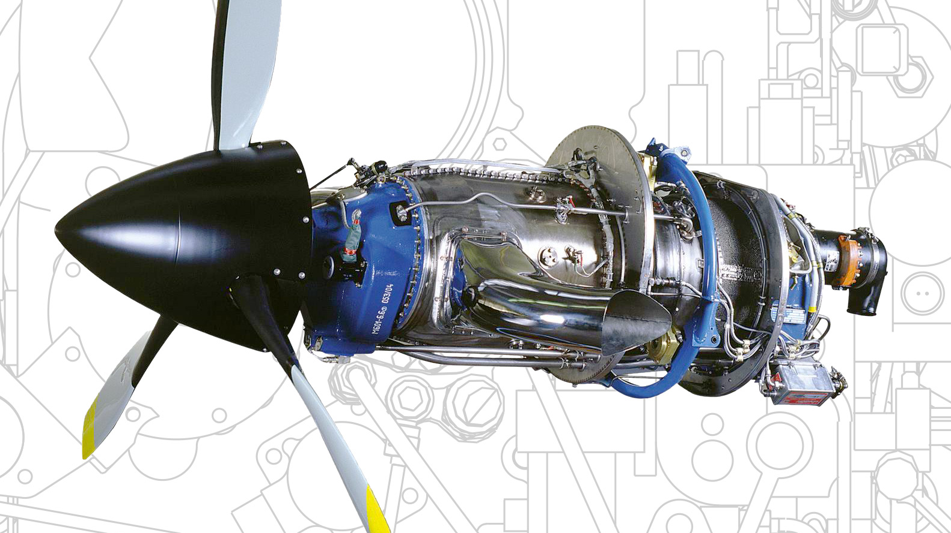

GEARBOX DESIGN FOR TURBOPROP AIRCRAFT ENGINE P
11/1/2021

Slide 2
CONTENT
Introduction
Design parameters and criteria
Comparison of planetary gearing systems
Structural and Dynamic analysis for the chosen System
Assembly video animation
Full assembly operation video
Results

Slide 3
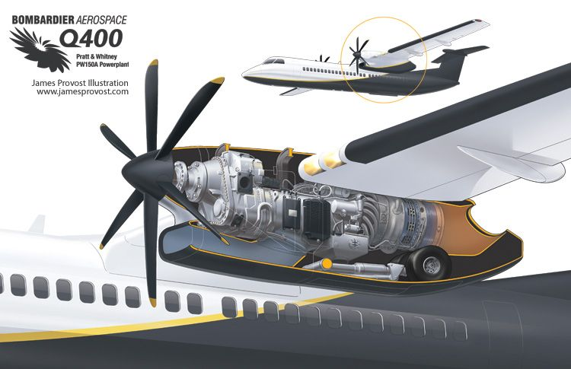
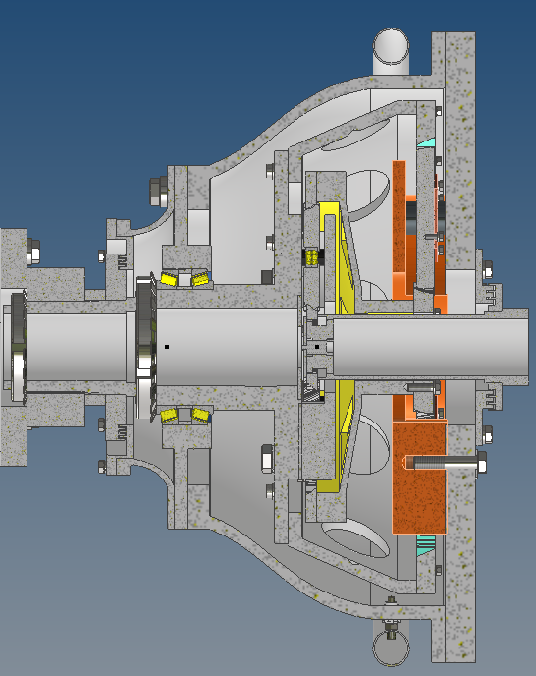
INTRODUCTION
Turboprop aircraft’s engine
Low altitude
Low flight velocity
Fuel efficiency
Engine– Reducer – Propeller
Rotational velocity reduction

Slide 4
DESIGN AND VALIDATION CRITERIA
Desired transmission rate i_{AB} = 16
Achieve as high a degree of efficiency as possible
Possibility of easy assembly and disassembly of the box
Low weight and small volume of the structure
Lubrication system for the proper functioning of the box

Slide 5
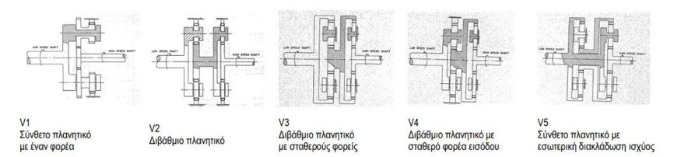
Planetary gearing systems

Slide 6
Comparison of design solutions
Teeth number
z1 | 21 | z4 | 21
z2 | 27 | z5 | 25
z3 | -75 | z6 | -75
 | i | η
V1 | 4,571429 | 0,984453 | 98,45%
V2 | 20,89796 | 0,963148 | 96,31%
V3 | 12,7551 | 0,960696 | 96,06%
V4 | -17,3265 | 0,960163 | 96,01%
V5 | 17,32653 | 0,96689 | 96,69%

Slide 7
POWER FLOW FOR PLANETARY V5
Σ₁
Σ₂
Φ₂
Π₁
Π₂
Propeller’s Thrust F_{u}
Η₂
Β
Α
Power Output P_{Β}
Η₁
Φ₁ common part Σ₁ – Η₂
Input Power P_{A}

Slide 8
Characteristics of specific Machine Elements
Three planets in each tier
Long toothed wheels
Oblique serration
Self-aligning barrel bearings
Pompous polyhedron
Better torque distribution
Small forces and weight
Elimination of axial loads between steps
Tilt angle error handling
Input sun self-adjustment capability

Slide 9
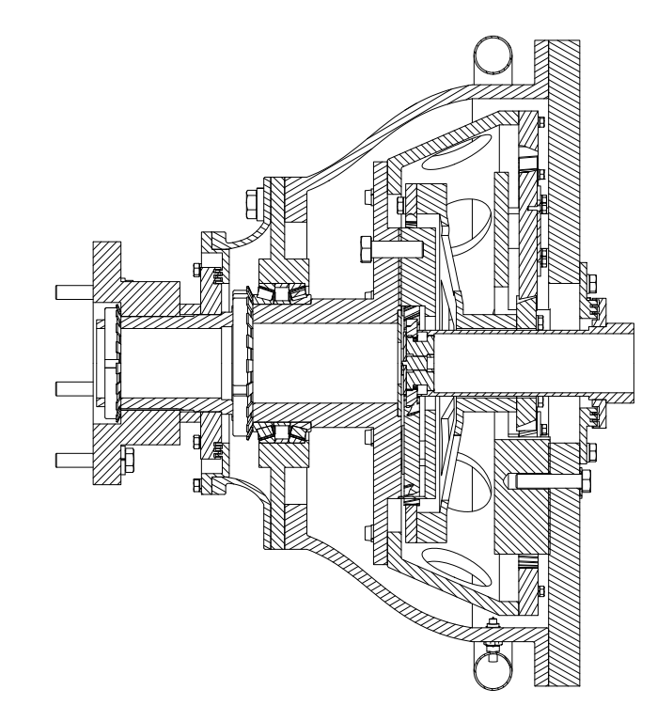
2D Cross – Section for the reducer
3
2
6
5
7
1
Entrance spindle2nd
Planetary Tier - Shell Cap
Corona 1st stage-Sun 2nd stage
Planetary 1st stage - Exit spindle
Left Shell part
Lubrication System
Flanged Link
4

Slide 10

Assembly animation
Body of the second tier

Slide 11
Assembly animation
Body of the first tier

Slide 12
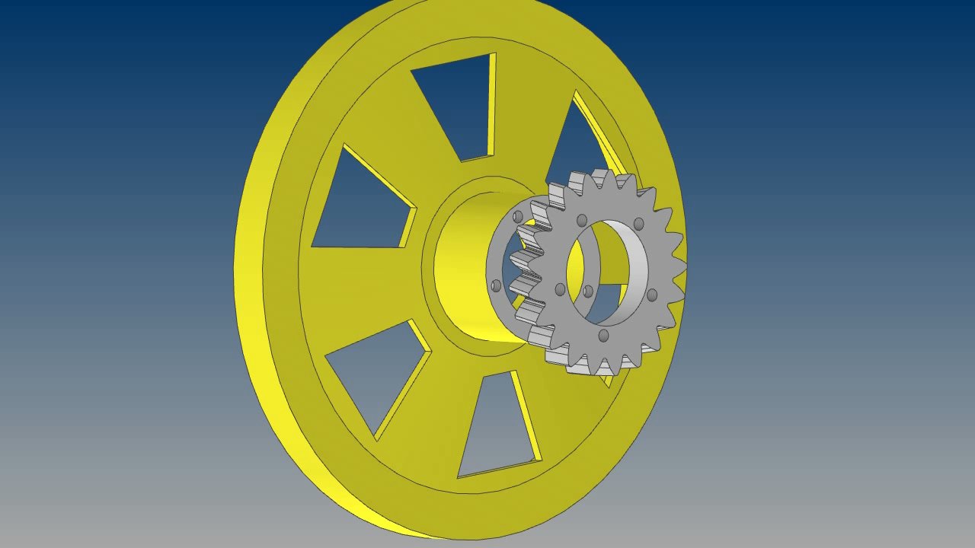
Assembly animation
Ring gear 1 - sun 2

Slide 13
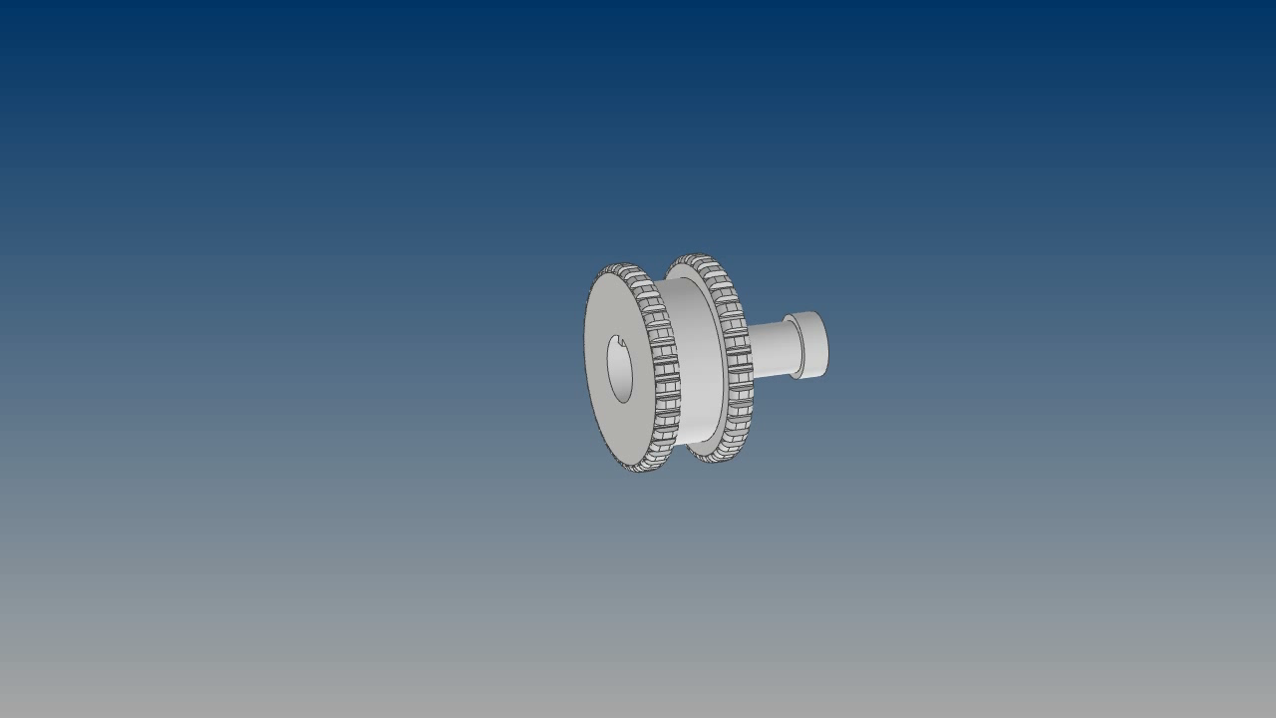
Assembly animation
sun 1- pompe

Slide 14
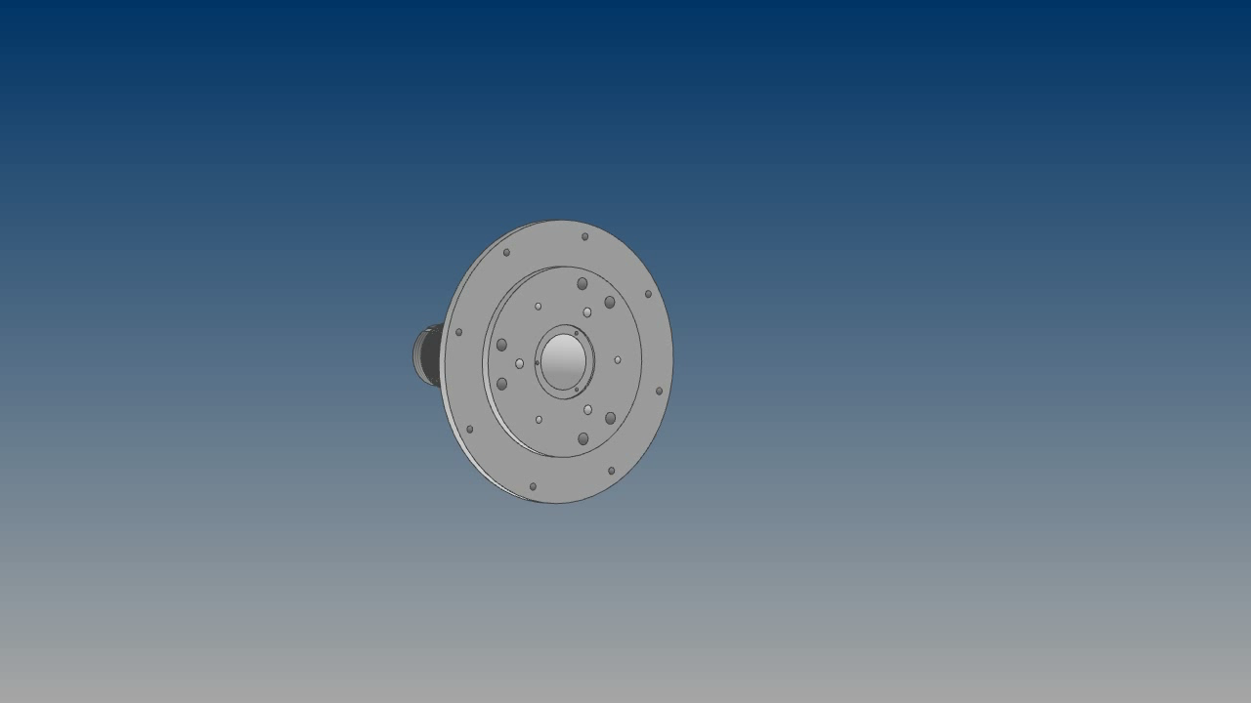
Assembly animation
Output shaft – first tier

Slide 15
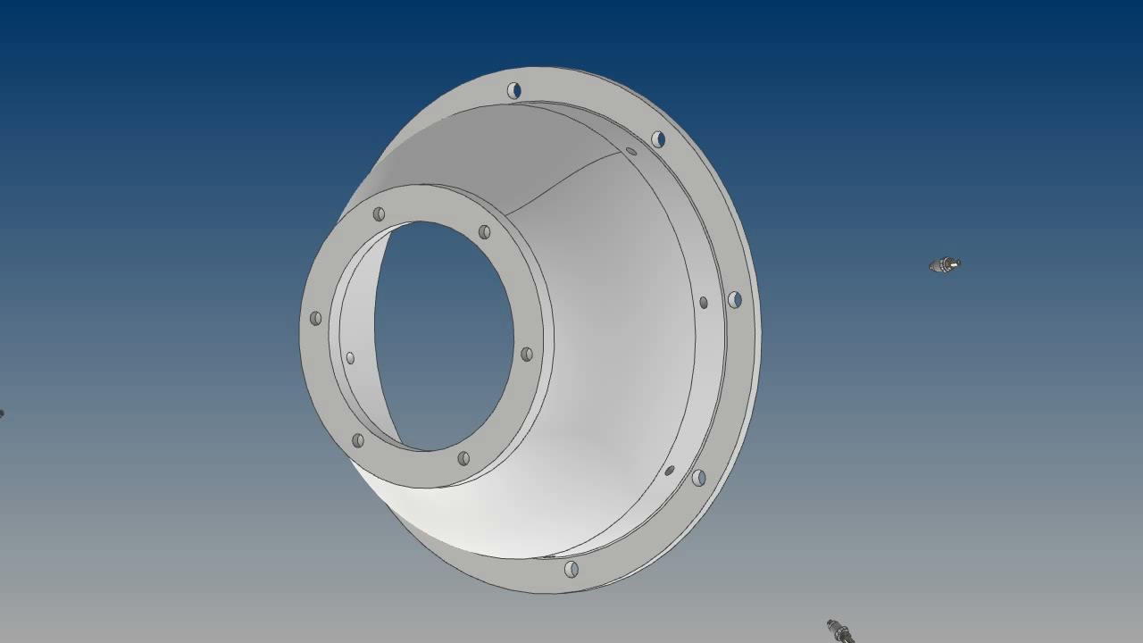
Assembly animation
Armature and lubrication ring

Slide 16
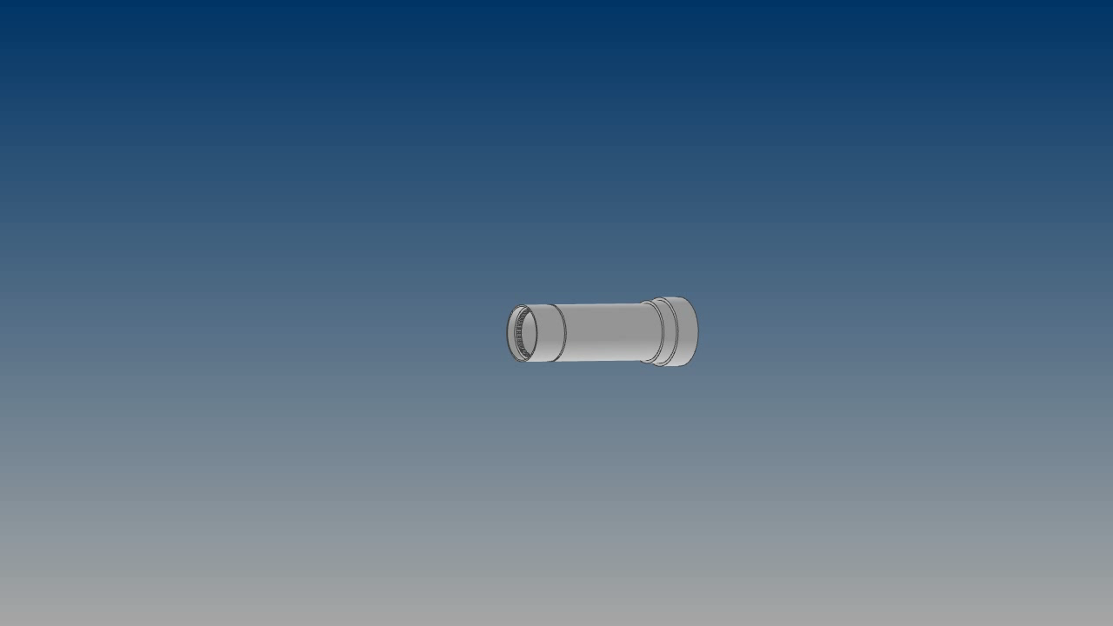
Assembly animation
Reducers’s Assembly steps

Slide 17
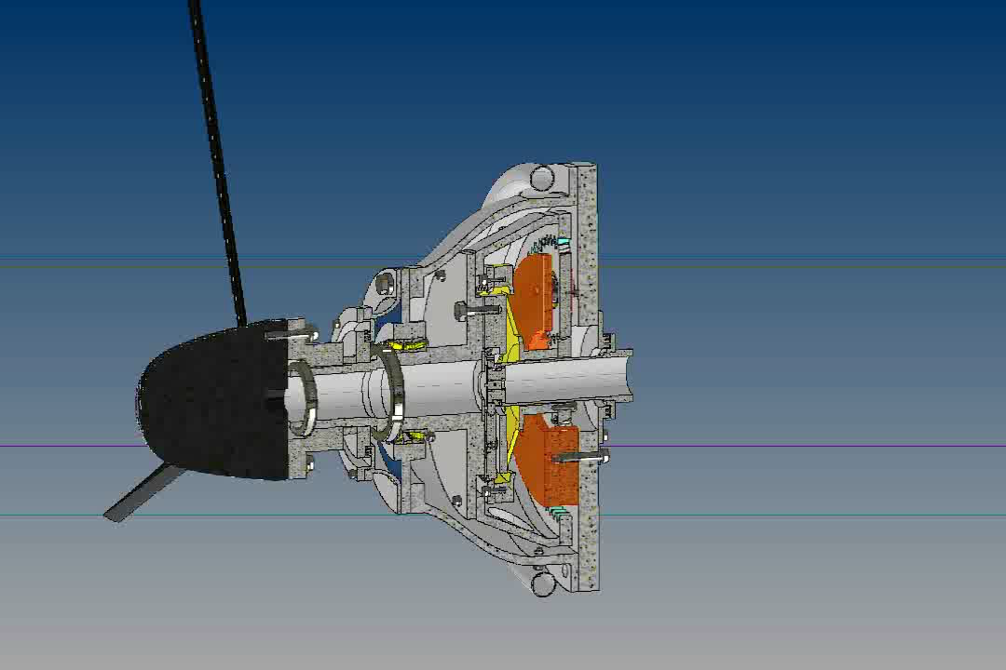
FULL ASSEMBLY OPERATION VIDEO

Slide 18
Results
Low power to weight ratio (0.272 kg/kW)
High efficiency (96.69 %)
Desirable gear ratio (17.3)
Easy assembly
Smooth power flow

